Slide 1
2017 Image Deblurring Competition Description
Author/ Email: caijia
Version: V1.0(20171012)

Slide 2
Index
Background
Input
Goal
Materials
Evaluation Method

Slide 3
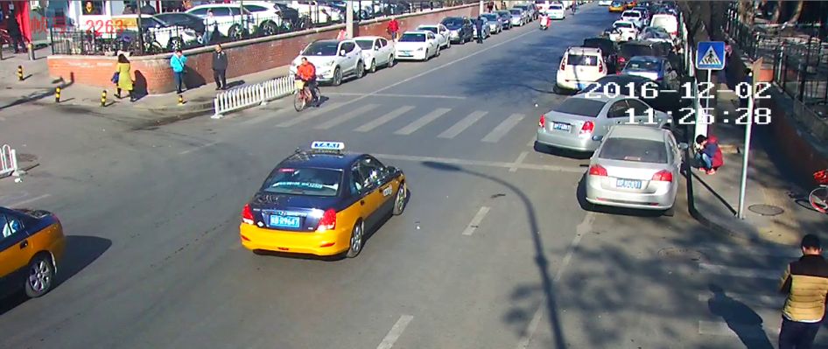
Background
This competition aims to motivate research around Deblurring technology and its application in the specific context of License Plate (LP) images.
In the scene of surveillance, sometimes images photographed by IP Cameras are not so clear and ideal due to a variety factors. Among them, blurring images are a big challenge to our license plate recognition (LPR).
In order to improve our system performance, we expect the technology of image deblurring can solve this practical problem.

Slide 4


Input
The cropped LP images (by our detection method or select manually)
Size of LPs: 60pix×15pix~200pix×50pix
The pictures are taken with a stationary camera in theory.
Motion blur – Different blur lengths, max is about 25 pixels.
Different direction ranges, 0~180°.
Out-of-focus /Gaussian blur – The size is smaller than 20x20.
Noise – Very complicated in different images of low quality.
Compression –Images are formatted .jpg/.png, etc.

Slide 5

Examples

Slide 6
Goal
One purpose of doing deblurring work is to go further than what can be physically seen.
The original images are not discernible. After processing, we can recognize those characters by the naked eyes.
The accuracy ratio using our DL based recognition method can be improved.
There are no restrictions on what methods may be used.
Traditional or deep learning based methods are both accepted.

Slide 7
Materials
Images
4000 clear cropped LP images, photographed by IP Cameras in surveillance scenes. (for training if necessary)
100 labeled blurred LP images, photographed by IP Cameras in surveillance scenes. (for test)
Software
A scoring software, which can output the accuracy rate of input LP images’ characters. (for self-verifying)

Slide 8
Evaluation Method
Subjective test: experts evaluate the image quality after processed.
Objective test: we will use a scoring software (the same version will be given to participants) to evaluate the results. The higher accuracy rate, the higher score.
Final score: we will determine the weights of each index and obtain a comprehensive evaluated score.

